Slide 1







Running with Tiny bit
Dancer
Yahboom

Slide 2









Contents
Preparation
Learning goal
Search for blocks
Combine blocks
Experimental phenomena
Yahboom

Slide 3

Preparation
1.The position of the motor, buzzer, RGB lights on the robot car
Programming method:
Mode 1 online programming: First, we need to connect the micro:bit to the computer by USB cable. The computer will pop up a USB flash drive and click on the URL in the USB flash drive: http://microbit.org/ to enter the programming interface. Add the Yahboom package: https://github.com/YahboomTechnology/Tiny-bitLib to program.
Mode 2 offline programming: We need to open the offline programming software. After the installation is complete, enter the programming interface, click【New Project】, add Yahboom package: https://github.com/YahboomTechnology/Tiny-bitLib, you can program.
Yahboom

Slide 4
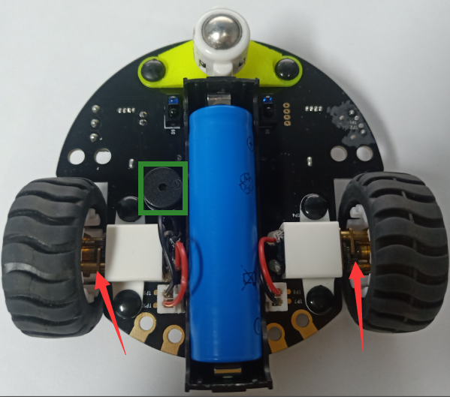
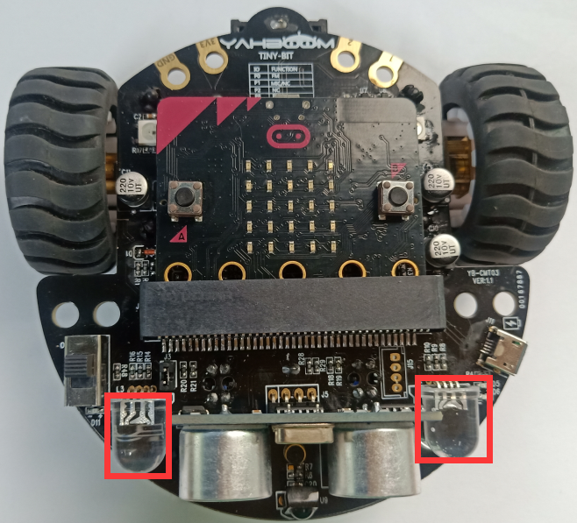
Preparation
As shown below, the red arrow points to the motor, the green wire frame is the buzzer, and the red wire frame is the RGB search lights.
Yahboom

Slide 5
Learning goal
1.Learn how to use control motor graphically program building blocks, music graphically program building blocks, RGB light graphically program building blocks.
2.The function is realized by programming: the buzzer will play the song "ODE", and RGB searching lights will change color, the car will advance, back, turn left, turn right, spin left, spin right.
Yahboom

Slide 6

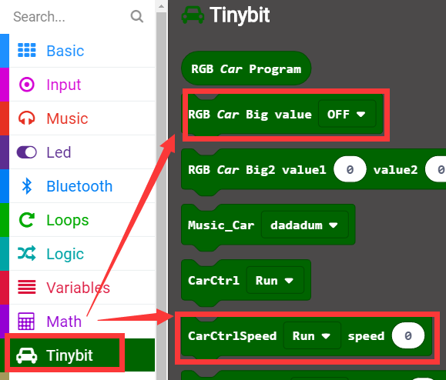
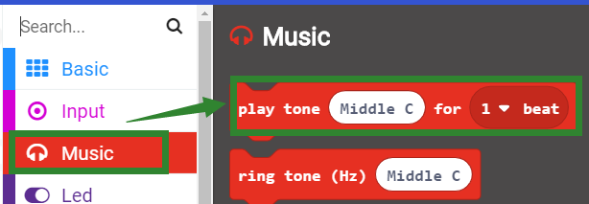
Search for block
The following is the location of the building blocks required for this programming.
Yahboom

Slide 7
Combine block
The summary program is microbit-Dancer.hex
Yahboom

Slide 8
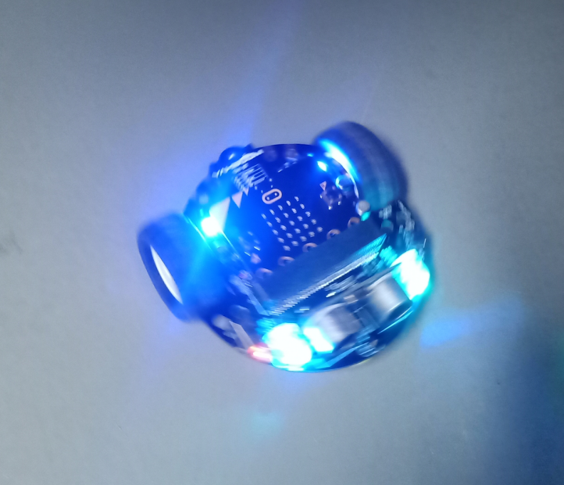
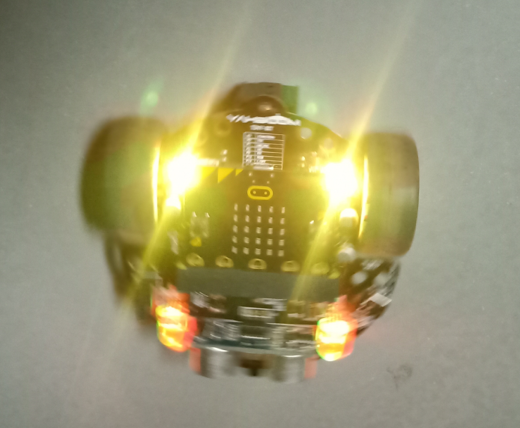
Experimental phenomena
After the program is downloaded, we can see the buzzer will play the song "ODE", and RGB searching lights will change color, the car will advance, back, turn left, turn right, spin left, spin right.
Yahboom

Slide 9
Inspire Creativity Embrace Innovation
Thank you!!!

